Slide 1
Lab Notes
Strings

Slide 2
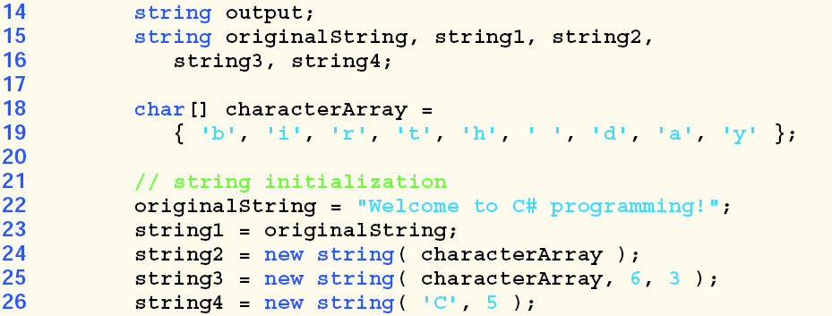
Creating Strings
You can create strings with the various constructors provided by C#

Slide 3
String methods
verbatim string the @ symbol enables you to display or work with the string as it is
string file = @"C:\MyFolder\MySubFolder\MyFile.txt";
Console.WriteLine(file);
toupper and to lower
string greeting = "hello";
Console.WriteLine(greeting.ToUpper());//HELLO
Console.WriteLine(greeting.ToLower());//hello

Slide 4
Cont
Substring(int) and Substring(int, int length_of_substring)
string sub_demo = "Substring text";
Console.WriteLine(sub_demo.Substring(5));//ring text
Console.WriteLine(sub_demo.Substring(0,9);//Substring
comparing strings(-1,0,11)
string s1 = "Hello world";
string s2 = "Hello";
Console.WriteLine(String.Compare(s1, s2));//1

Slide 5
Cont.
Concatenate String
Console.WriteLine("Concatenated String"+String.Concat(s1, s2));//hello world hello
Replace
string name1 = "Abebe";
string name2 = "Kebede";
name1 = name1.Replace(name1, name2);
Console.WriteLine(name1 + name2);

Slide 6
Cont.
String split method
string mystr2 = "This is a new string";
string[] words = mystr2.Split('s');
foreach (string w in words)
{ Console.WriteLine(w); }
Trim method
string mystr3 = " this is a spaced string ";
Console.WriteLine("Before trim");
Console.WriteLine(mystr3);
Console.WriteLine("After trim");
Console.WriteLine(mystr3.Trim());

Slide 7
Lab Exercise
Arrays and Strings

Slide 8
Exercise: Strings
Create String 3 string objects with the string constructors as shown in the example.
Display elements of a string onto the console screen using foreach loop.
Write a program in C# Sharp to print individual characters of the string in reverse order.
Test Data : Input the string : P R O G R A M
Expected Output :
The characters of the string in reverse are : M A R G O R P

Slide 9
Skyline Writing: Write a program that takes a string as an input and displays it in a skyline writing manner. Meaning that every other letter in the word is capitalized.
E.g input string is Hello World
Output string is HeLlO WoRlD

Slide 10
Write a program in C# Sharp to count the total number of words in a string.
Test Data :
Input the string : This is the second exercise
Expected Output :
Total number of words in the string is : 5

Slide 11
Capitalizing Words
Write a program that accept arbitrary string input from the user and converts the first letter of every word to uppercase.
Test Data : Input the string : hello my friends!
Expected Output :
Input with first letter uppercase: Hello My Friends!

Slide 12
Exercise: Arrays
Write a program in C# Sharp to find maximum and minimum element in an array.
Test Data : Input elements in the array : 12 56 8 97 14 10
Expected Output : Maximum element is : 97 Minimum element is : 8
Write a program to find the number of even and odd integers in a given array of integers.

Slide 13
Cont.
Write a method in C# to count the frequency of a given element of an array.
Test Data : Input elements in the array : 22 26 14 22 14 22
Expected Output : Enter the number: 22
Occurrence of 22 is 3

Slide 14
Cont.
Write a program to find second largest element in an given array of integers
Sample Output:
secondLargestElement([12,3,5,10 ]) → 10

